Slide 1

Analysis of different sorting algorithms

Slide 2
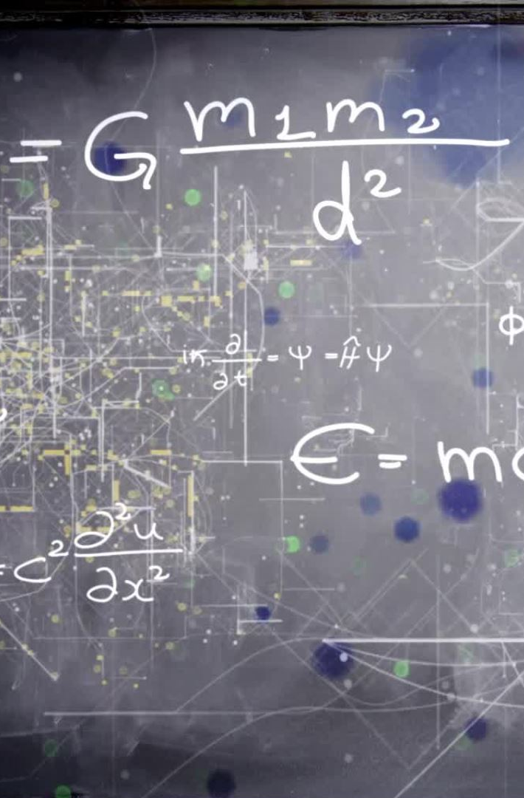
Analysis of Bubble sort algorithm
Algorithm
1. Start
2.i=0
3.While i<n-1
1. j=0
2. While j<n-1-i
1. If a[j]>a[j+1]
1.temp=a[j]
2. a[j]=a[j+1]
3. a[j+1]=temp
2.end if
3. j=j+1
3.end while

Slide 3
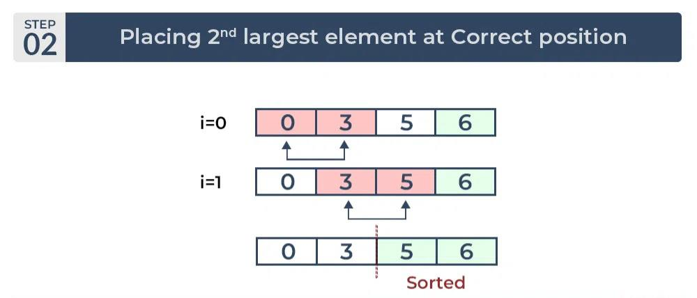
Analysis of Bubble sort algorithm

Slide 4
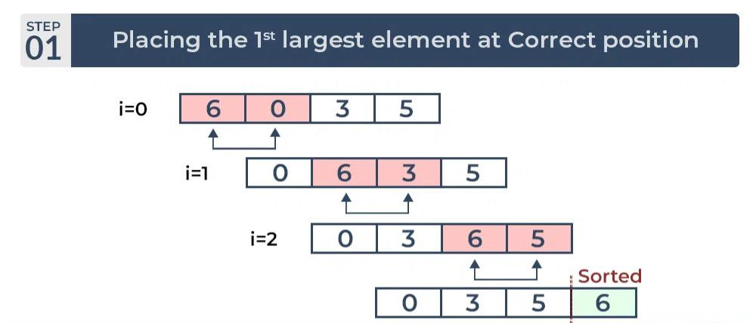
Analysis of Bubble sort algorithm

Slide 5
Analysis of Bubble sort algorithm
If we are given n elements,
in the first pass, it will do n-1 comparisons;
in the second pass, it will do n-2 comparisons;
in the third pass, it will do n-3 comparisons and so on.
Thus, the total number of comparisons can be found by; 1 + 2 + 3 + ...(n-3) +(n-2) + (n – 1) =n(n - 1)/2 = O(n²)

Slide 6
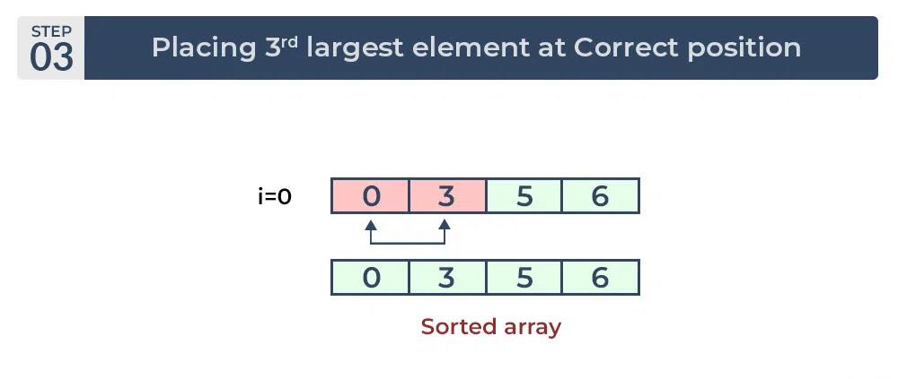
Analysis of Bubble sort algorithm

Slide 7
Analysis of insertion sort
Algorithm
.start 2. i=1 3. While i<n
1. j=i
2. While a[j]<a[j-1] and j>0 1. t=a[j] 2. a[j]=[j-1] 3. a[j-1]=t 4. j=j-1 3.end while
4. i=i+1 4.end while 5. stop

Slide 8

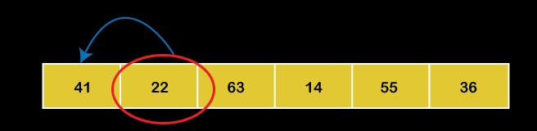

Analysis of insertion sort

Slide 9
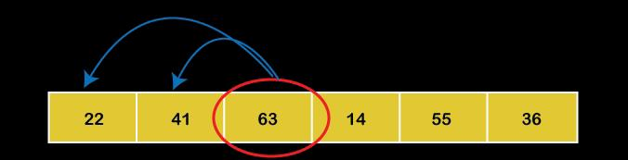
Analysis of insertion sort

Slide 10
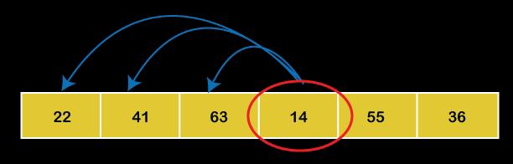

Analysis of insertion sort

Slide 11
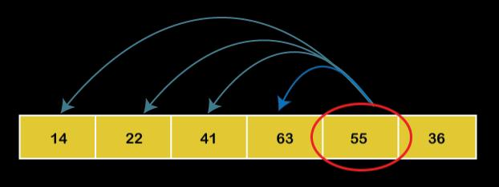
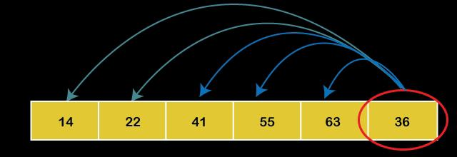

Analysis of insertion sort

Slide 12
Analysis of insertion sort
If we are given n elements,
then in the first pass, it will make n-1 comparisons; in the second pass, it will do n-2 comparisons; in the third pass, it will do n-3 and so on.
Thus, the total number of comparisons can be found by;
(n-1) + (n-2) + (n-3) + (n-4) + ...... + 1
O(n²)

Slide 13
Analysis of selection sort
Algorithm
1: Start
2. i=0
3. while i<n-1 do
1. j=i+1
2. small=i
3. while j<n do
1.if a[small]>a[j]
1. small=j
2.end if
3. j=j+1
4. end while
5. if i!=small
1. temp=a[i]
2. a[i]=a[small]
3. a[small]=temp
6.end if
7. i=i+1
7. end while
8. stop

Slide 14
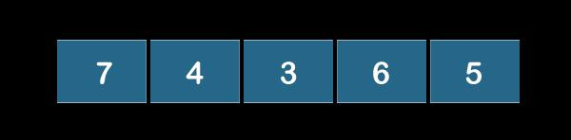
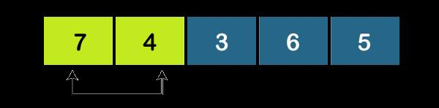
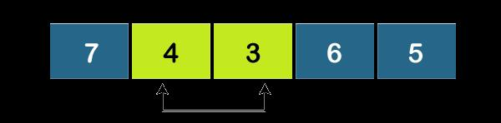
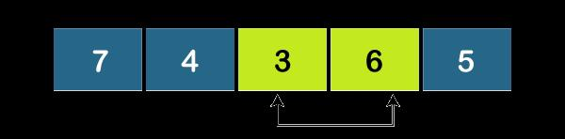
Analysis of selection sort

Slide 15
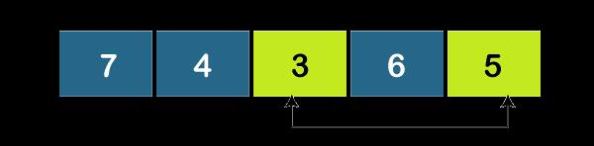
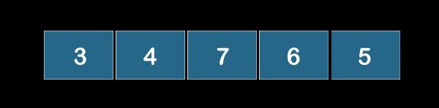
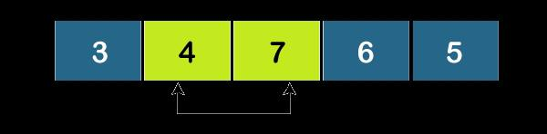
Analysis of selection sort

Slide 16
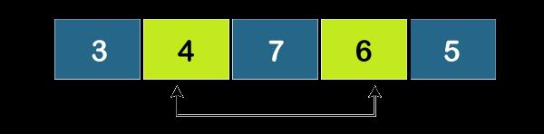
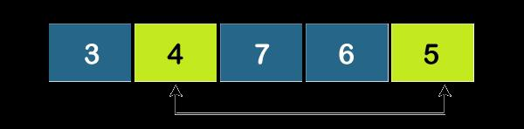
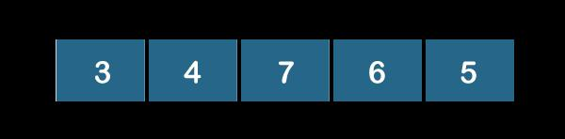
Analysis of selection sort

Slide 17
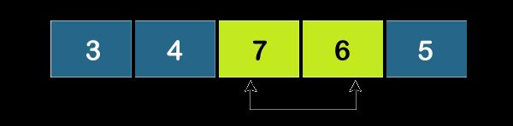
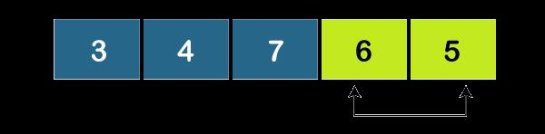
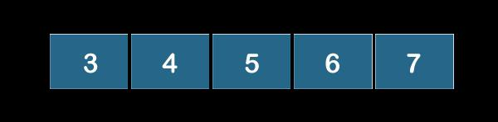
Analysis of selection sort

Slide 18
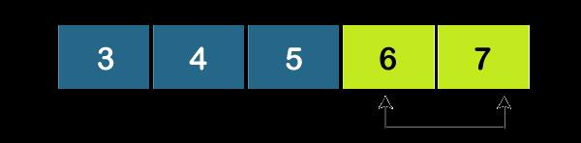
Analysis of selection sort

Slide 19
Analysis of Mergesort algorithm
falls under the category of Divide and Conquer technique.
we segment a problem into two halves and solve them individually. After finding the solution of each half, we merge them back to represent the solution of the main problem.

Slide 20
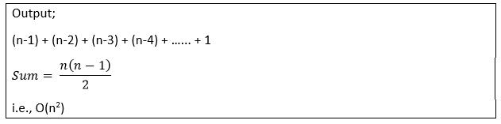
Analysis of selection sort
If we are given n elements,
then in the first pass, it will do n-1 comparisons;
in the second pass, it will do n-2;
in the third pass, it will do n-3 and so on. Thus, the total number of comparisons can be found by;

Slide 21
Analysis of Mergesort algorithm

Slide 22
Analysis of Mergesort algorithm
Merge sort is a recursive algorithm, recursive equation can be wriiten as
T (n) be the total time taken by the Merge Sort algorithm
Sorting two halves will take at the most 2T (n/2) time
Merging it takes n times hence
T (n) =2T + +n

Slide 23

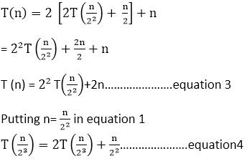
Analysis of Mergesort algorithm
Put 2 equation in 1 equation

Slide 24
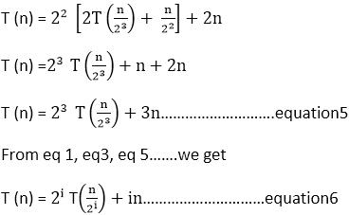
Analysis of Mergesort algorithm
Putting 4 equation in 3 equation

Slide 25
Analysis of quick sort
efficiency of the Quicksort algorithm very much depends on the selection of the pivot element.
assume the input of the Quicksort is a sorted array and we choose the leftmost element as a pivot element.
In this case, we’ll have two extremely unbalanced arrays. One array will have one element and the other one will have elements.

Slide 26


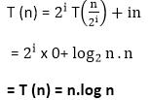
Analysis of Mergesort algorithm
Apply log both sides:
log n=log₂i logn= i log2 =i log₂n=i
From 6 equation
From Stopping Condition:

Slide 27
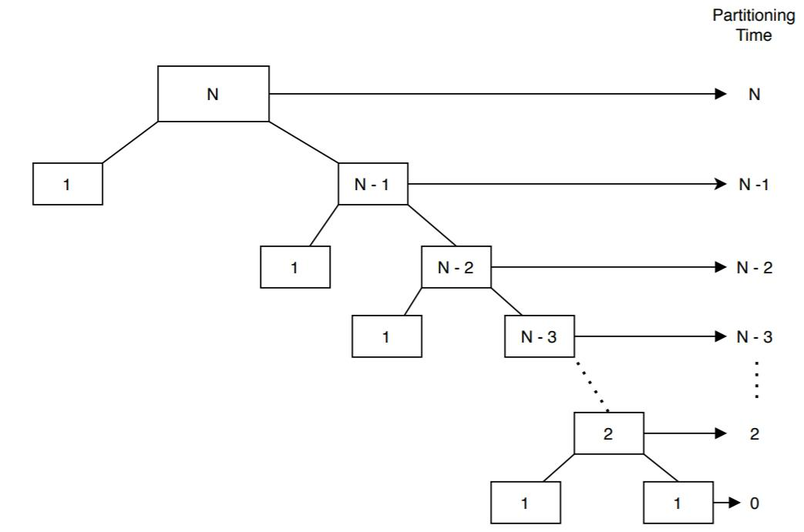
Analysis of quick sort

Slide 28
Analysis of quick sort
time complexity of the Quicksort algorithm in worst case is

Slide 29
Analysis of quick sort
Can create a recurrence relation for computing it. In the worst case, after the first partition, one array will have 1 element and the other one will have (N-1) elements. Let’s say T(N) denotes the time complexity to sort N elements in the worst case:
T(N) =Time needed to Partition N elements+Time needed to sort N-1 elements recursively
T(N) =N+T(N-1)

Slide 30
Analysis of quick sort
To solve the recurrence relation we derived earlier: T(N) = N + T(N- 1),
T(N – 1) = (N – 1) + T(N- 2),
T(N – 2) = (N – 2) + T(N- 3),
T(N – 3) = (N – 3) + T(N- 4), .......... ,
T(3) = 3 + T(2),
T(2) = 2 + T(1),
T(1) = 0

Slide 31
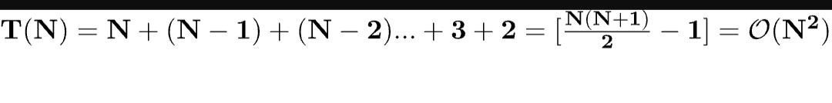
Analysis of quick sort

